Slide 1
IoT Security Issues
國立中正大學資工系 黃仁竑教授

Slide 2
Outline
Background
DDoS
Mirai
Conclusion

Slide 3
Background
IoT devices have become a powerful amplifying platform for cyberattacks
Large volume, pervasiveness, and high vulnerability
Increasing number of IoT devices (50 billions!!)
Good target for botnet
Processing power limited embedded system
Less secured system
Constantly connected to the Internet
Permeated with flaws
Naive security configurations
Vehicle for DDOS attacks

Slide 4
History
Mirai botnet first identified in August 2016 by MalwareMustDie research group.
In September 2016, the website of computer security consultant Brian Krebs was hit with 620 Gbps of traffic.
At about the same time, an even bigger DDoS attack peaking at 1.1 Tbps, targeted the French webhost and cloud service provider OVH.
In October 2016, service provider Dyn was took down hundreds of websites, including Twitter, Netflix, Reddit, and GitHub, for several hours.

Slide 5
History
In November 2016, Mirai variant knocked nearly a million Deutsche Telekom subscribers offline.
In February 2017, a Mirai variant launched a 54-hour-long DDoS attack against a US college.
Persirai is active since April 2017, another IoT botnet that shares Mirai’s code base
Estimated 120,000 devices are vulnerable to Persirai
Exploiting a documented zero-day flaw that lets attackers directly obtain the password file.
DDoS attack based on UDP flooding

Slide 6
New Business
After open source of Mirai
hackers offered Mirai botnets for rent with as many as 400,000 simultaneously connected devices.

Slide 7
Basic Concept of Mirai
Mirai primarily spreads by first infecting devices such as webcams, DVRs, and routers.
It then deduces the administrative credentials of other IoT devices by means of brute force (by breaking username–password pairs using dictionary).
Notes:
DVR: Digital Video Recorder
NVR: Network Video Recorder

Slide 8
Main Components of Mirai
Command and control (C&C)
The C&C server provides the botmaster with a centralized management interface to check the botnet’s condition and orchestrate new DDoS attacks.
Loader
The loader facilitates the dissemination of executables targeting different platforms (18 in total, including ARM, MIPS, and x86) by directly communicating with new victims.
Report
The report server maintains a database with details about all devices in the botnet.

Slide 9
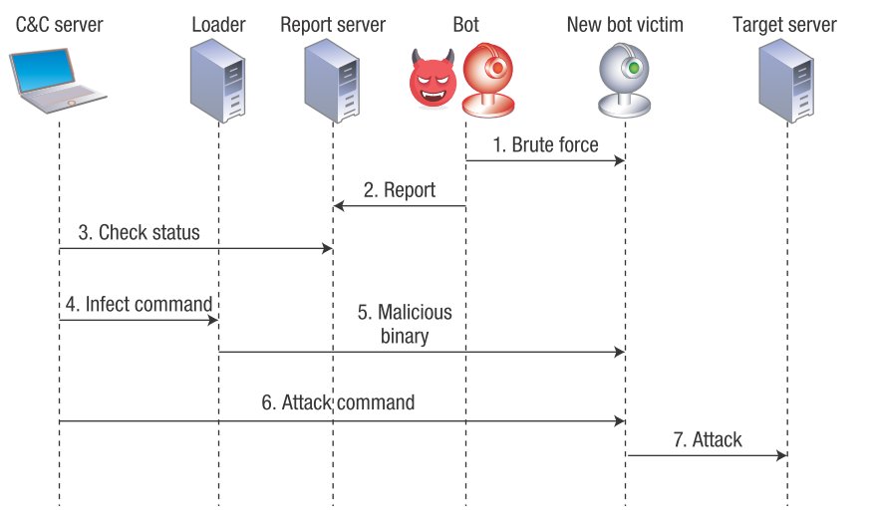
Mirai Botnet Operation and Communication
Constantinos Kolias, Georgios Kambourakis, Angelos Stavrou, Jeffrey Voas, “DDoS in the IoT: Mirai and Other Botnets,” IEEE Computer, Volume 50, Issue 7, pp. 80-84, 2017.
Notes:
Constantinos Kolias, Georgios Kambourakis, Angelos Stavrou, Jeffrey Voas, “DDoS in the IoT: Mirai and Other Botnets,” IEEE Computer, Volume 50, Issue 7, pp. 80-84, 2017.

Slide 10
Mirai Botnet Operation
Initially, Mirai scans random public IP addresses through TCP ports 23 or 2323.
The bot engages in a brute-force attack to discover the default credentials of weakly configured IoT devices (username–password pairs)
Upon breaking the credentials and gaining a shell interface, the bot forwards various device characteristics to the report server through a different port.
Via the C&C server, the botmaster frequently checks new prospective target victims as well as the botnet’s current status by communicating with the report server.
After deciding which vulnerable devices to infect, the botmaster issues an infect command in the loader.

Slide 11
Mirai Botnet Operation
The loader logs into the target device and instructs it to download and execute the corresponding binary version of the malware.
Wget www.gnu.org/software/wget/manual /wget.html
The newly recruited bot instance can communicate with the C&C server to receive attack commands.
The botmaster instructs all bot instances to commence an attack against a target server.
Via port 7547, which ISPs use to remotely manage customers’ broadband routers.
The bot instances will start attacking the target server with one of 10 available attack variations such as Generic Routing Encapsulation (GRE), TCP, and HTTP flooding attacks.

Slide 12
Detecting Mirai
Mirai signatures
sequentially testing specific credentials in specific ports
sending reports that generate distinctive patterns
downloading a specific type of binary code
exchanging keep-alive messages
receiving attack commands that have a specific structure
generating attack traffic with very few random elements

Slide 13
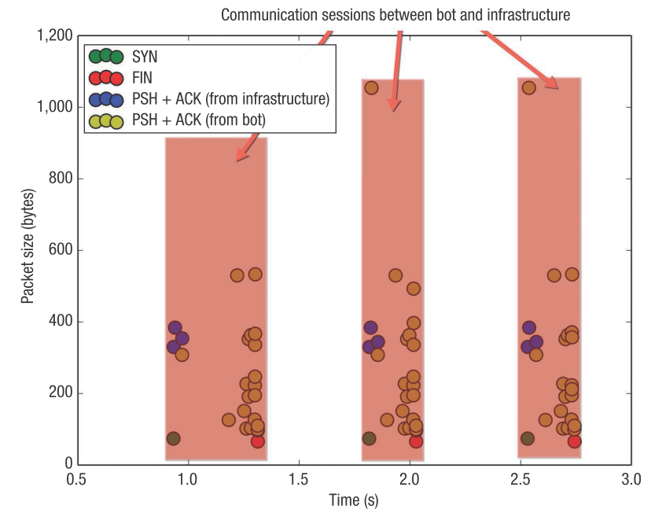
Communication Pattern of Mirai
Notes:
The sending application informs TCP that data should be sent immediately.
The PSH flag in the TCP header informs the receiving host that the data should be pushed up to the receiving application immediately.

Slide 14
Other IoT Bots
LuaBot
Reported in August 2016, written in Lua programming language, encrypted C&C communication channel
Hajime botnet
Discovered in October 2016, infection method similar to Mirai, used a centralized architecture (BitTorrent DHT), message is RC4 encrypted
BrickerBot
Discovered in April 2017, leverage SSH service default credentials, misconfigurations, or known vulnerabilities, perform permanent denial-of-service (PDoS) (e.g., defacing firmware)

Slide 15
Lessons Learned
Five main reasons IoT devices are particularly advantageous for creating botnets:
Constant and unobtrusive operation
Feeble protection
Poor maintenance
Considerable attack traffic
IoT devices are powerful enough and well situated to produce DDoS attack traffic
Noninteractive or minimally interactive user interfaces
infections are more likely to go unnoticed
Notes:
>Constant and unobtrusive operation. Unlike laptop and desktop computers, which have frequent on–off cycles, many IoT devices such as webcams and wireless routers operate 24/7 and in many cases aren’t properly recognized as computing devices. (unobtrusive 不顯眼的)
>Feeble protection. In their rush to penetrate the IoT market, many device vendors neglect security in favor of user-friendliness
and usability.
>Poor maintenance. Most IoT devices fall under the setup-and-forget umbrella— after initially setting them up, users and network administrators forget about them unless they stop working properly. (Feeble 微弱)
>Considerable attack traffic . Contrary to common belief, IoT devices are powerful enough and well situated to produce DDoS
attack traffic comparable to that of modern desktop systems.
>Noninteractive or minimally interactive user interfaces. Because IoT devices tend to require minimum user intervention, infections are more likely to go unnoticed. Even when they’re noticed, there’s no easy way for the user to address them short of replacing the device.

